Slide 1


3 March 2023, 10:00 – 11:30 a.m. EST
Virtual Dialogue on
The 2023 Global Sustainable Development Report (GSDR)
between the Independent Group of Scientists (IGS)
and Private Sector Representatives

Slide 2
AGENDA
Welcome remarks
Presentation on Preliminary Findings and Recommendations of the 2023 Global Sustainable Development Report (GSDR)
Moderated discussion with private sector representatives
Q&A with audience
Closing thoughts

Slide 3
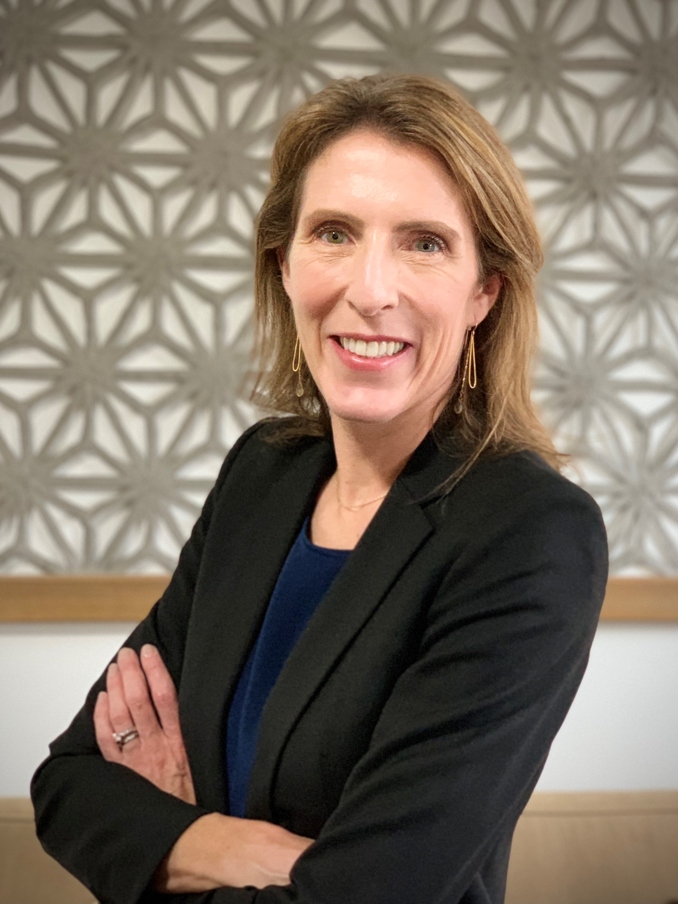
Welcome Remarks
Ms. Astra Bonini
Senior Sustainable Development Officer
Division for Sustainable Development Goals United Nations Department of Economic and Social Affairs

Slide 4
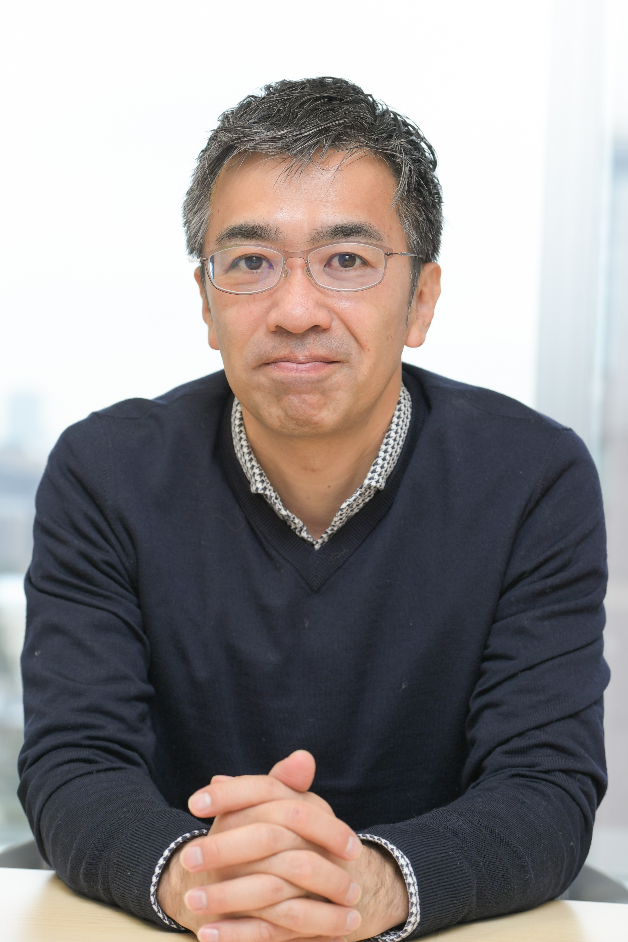
Presentation on Preliminary Findings and Recommendations of the 2023 Global Sustainable Development Report (GSDR)
Professor Norichika Kanie
Keio University; Member of the Independent Group of Scientists appointed by the Secretary-General to draft the 2023 GSDR

Slide 5

A glance at the 2023 Global Sustainable Development Draft Report
Virtual Dialogue on the 2023 Global Sustainable Development Report (GSDR) between the Independent Group of Scientists (IGS) and Private Sector Representatives
Members of the Independent Group of Scientists (N=15)
Prof. Norichika Kanie, Professor, Keio University and Director, xSDG Lab at Keio SFC Research Institute
Notes:
Thank hosts

Slide 6
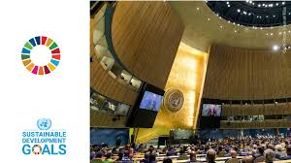
Global Sustainable Development Report 2023
An evidence base for SDG Summit – once in four years
Strengthen the science-policy interface
An assessment of assessments
Extensive input including Regional Consultations: South America, Southeast Asia, Africa, Western Asia
Draft delivered to Member States recently
15 IGS members very much looking forward to feedback
SDG Summit – UN General Assembly, 19-20 September, 2023

Slide 7

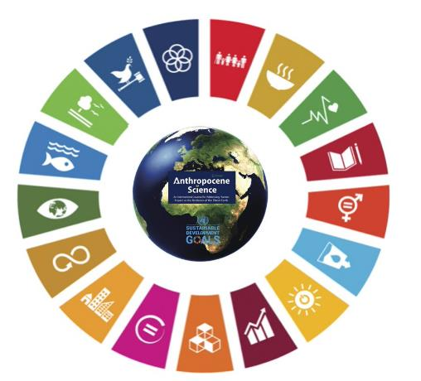
CONTEXT
We are in the Anthropocene...➔ social vulnerability.
In the 2020s ➔ Multiple Compounding Global Risks: climate change, biodiversity loss, geopolitical conflict, financial instability, COVID19 and natural disasters ➔ Escalating social vulnerability.
Notes:
A key assumption is that we live in the Anthropocene Age, where human impacts dominate the planet, so we really are addressing the impact of the human species on how our planet functions that includes the atmosphere(climate change), lands(deforestation), freshwater (pollution),oceans (overfishing plastics, acidification), and finally- biodiversity loss through all of those impacts
GEC=
atmosphere, hydrosphere, global oceans, cryosphere, polar regions, forests, land, freshwater, and biodiversity

Slide 8



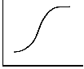
IGS 2023 wanted to…
Keep a Focus on the INTEGRATED perspective of SDGs to avoid trade-offs and international spillovers
Use Theory of Change that could help accelerate actions at key phases.
…. sense of urgency AND a sense of hope
Notes:
The SDG Ecosystem/Universe/world is large and growing, as you;ll see, so as the IGS, how can we contribute- Focus on how Acceleration of SDGS through a holistic perspective, and recognizing
1-A better understanding of patterns of synergies and trade-offs can support strategic decision making and promote interventions for the SDGs.
2-work that can help decision makers find synergies and minimize tradeoffs.
IMAGE FROM: https://link.springer.com/journal/44177/volumes-and-issues/1-3

Slide 9

Global Sustainable Development DRAFT Report 2023
Chapters
1: Half-way To 2030
2: Framing The Future
3: Accelerating Transformations to SDGs
4: Transformations Through Science
5: Call To Actions

Slide 10

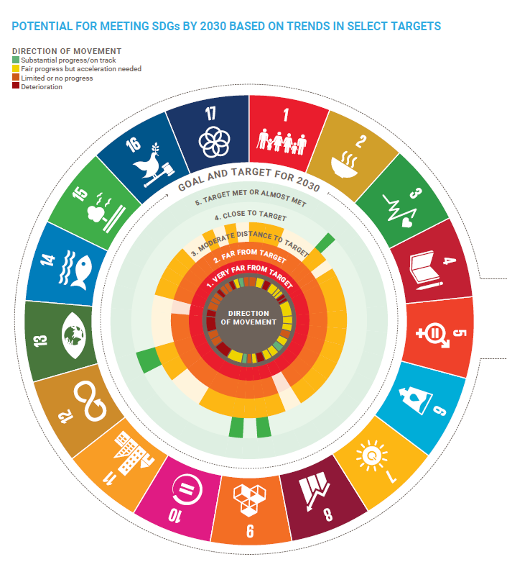
Chapter1: HALF-WAY TO 2030 – PROGRESS TOWARDS THE SUSTAINABLE DEVELOPMENT GOALS
Evaluating progress since 2015 and 2019, all SDGs
Focusing on Colors and DIRECTION OF MOVEMENT
Slowing down of progress
Reversed progress on several goals
Still negative trends on environment- and inequality-related goals
Crises or ‘scarring’ effects-including COVID19
Notes:
NB/ Verify time frame of direction of movement(not clear from text)

Slide 11

Chapter 2: Framing the future
There is ample room to both prepare for and shape the future – up to 2030 and beyond
Planning for medium-term trends that will predictably affect prospects for SDGs
A warming climate, with losses and damages but also low-carbon opportunities
Losses in nature and biodiversity, putting 50% of GDP at risk
A digital transformation – net effect for sustainable development?
Demographic change, altering the workforce and consumption patterns
Growing economic inequalities, increasing social tensions

Slide 12
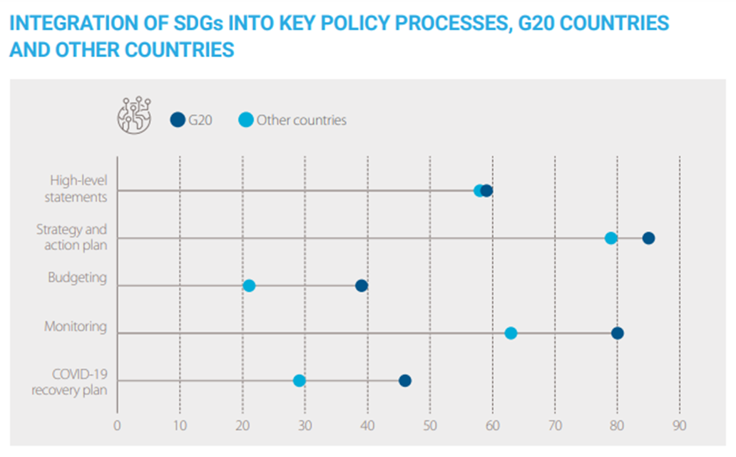
SDG action and governance
Broad awareness – the SDG framework is robust
Increasing commitments, partnerships and institutional mechanisms
Weak links
Financing and budgeting
International cooperation
Accountability
SDSN, 2022. SDG Index

Slide 13
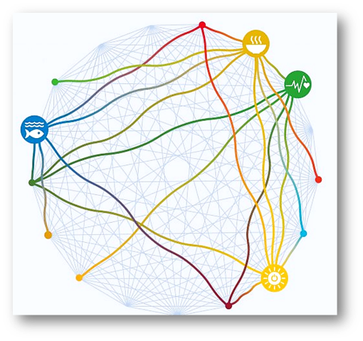
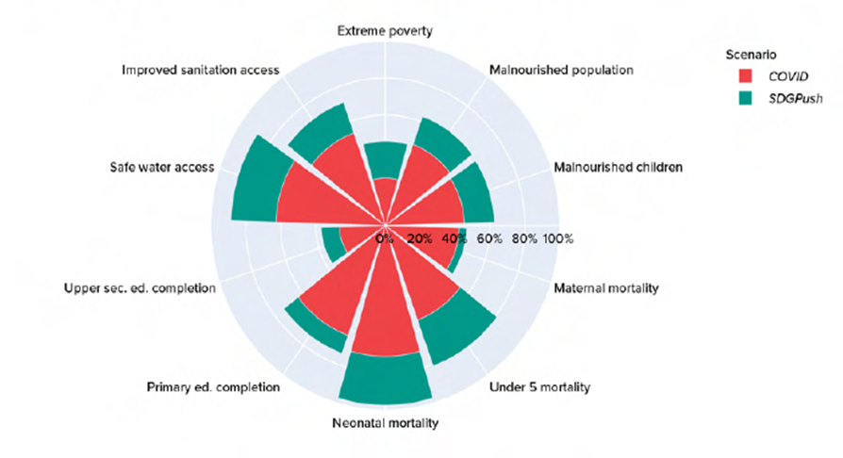
Incorporating new scientific knowledge
We have new science-based tools and data:
SDG interlinkages
Which SDGs are particularly synergistic or involve trade-offs?
International spillovers
How are we interdependent?
Scenario modelling
Where are we heading, and what if we change?
Need for accelerated and intensified science-policy-society collaboration, with a clear focus on action and implementation.
Hughes et al. 2021

Slide 14
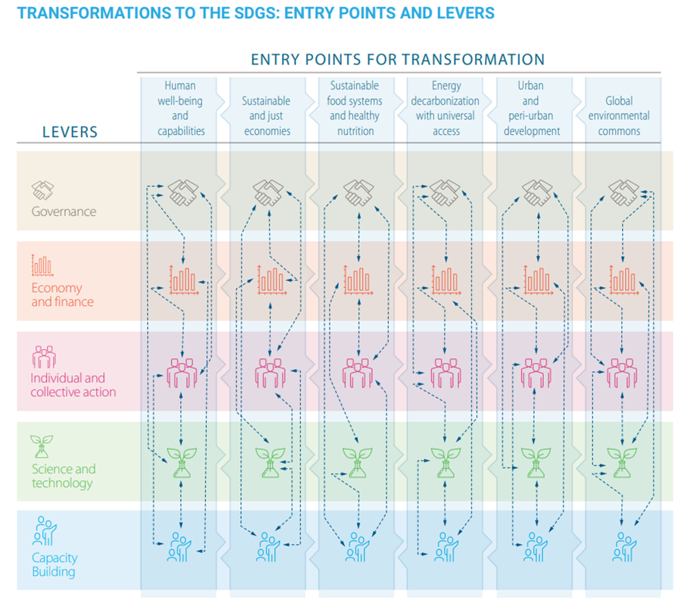
Transformative change and key interventions
2019 GSDR framework
New lever: Capacity-building
Example key interventions:
Universal health coverage, doubled health budgets
Universal social insurance, double R&D budgets
Public procurement for sustainable diets, green fertilizer mandate
Carbon pricing, EV mandates, coal phase-out
Public transport investment, access to basic services
Payment for nature-based solutions, secure land tenure, metrics beyond GDP
Take an integrated and dynamic approach

Slide 15
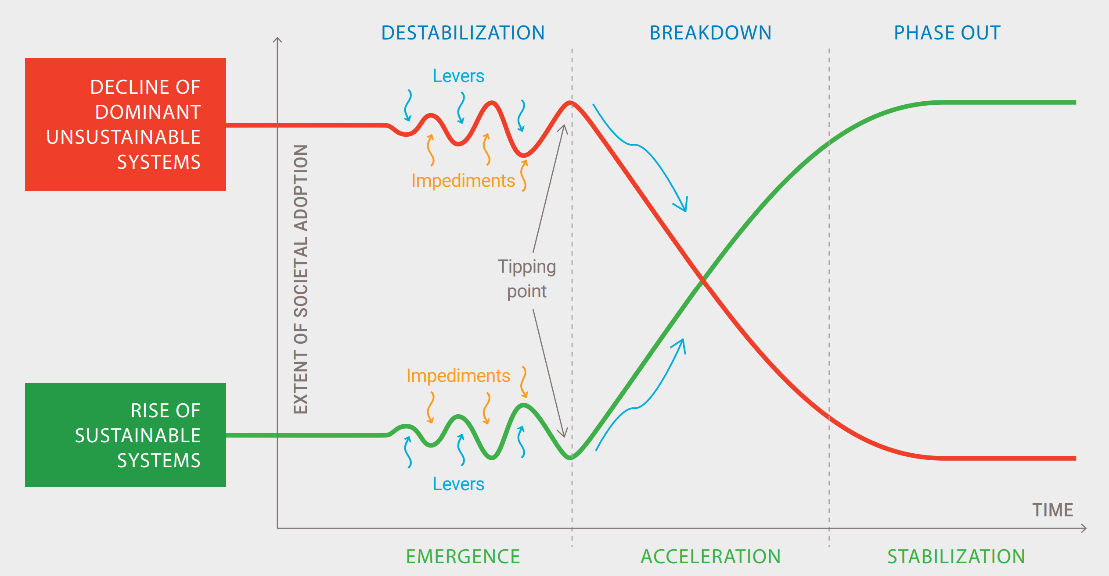
Chapter 3: Accelerating Transformations to SDGs
Can we strategically enable SDG solutions to move from emergence to acceleration to stabilization – tracing an S-curve?
Notes:
In the previous slides, we spoke of global scenario projections based on sustainability pathways, compared to business as usual. We identified core sets of interventions that would work synergistically along an integrated pathways to achieve the SDGs- as key shifts to accelerate transformations . But the timing of these interventions is also key—
A successful transformation can be considered in three phases – emergence, acceleration and stabilization – that trace an S-curve (figure 3-1). The first, emergence phase is when innovative ideas slowly give rise to new technologies and practices that operate in niches and on the fringe, often through experimentation and learning. During the second acceleration phase these innovations gain momentum and reach tipping points beyond which they are widely shared and adopted, leading to rapid, growth. Finally, in the third, stabilization phase these technologies and practices become embedded in daily life as the new normal. S-curves work in both directions. The rise in innovative technologies and practices aligned with the SDGs would be mirrored by a decline in unsustainable technologies, institutions and practices. This reverse S-curve has three corresponding phases: destabilization, breakdown and phase-out.
For example, the rise of renewable energy systems or electrified transport, is being matched by the decline of fossil-fuel energy and internal combustion vehicles. Similarly, the rise of sustainable agricultural systems and dietary practices will be accompanied by a decline in conventional, unsustainable agriculture and diets. Policy makers can intervene along both of these curves – using different levers to overcome impediments and support positive options while also destabilizing and breaking down unsustainable configurations.

Slide 16
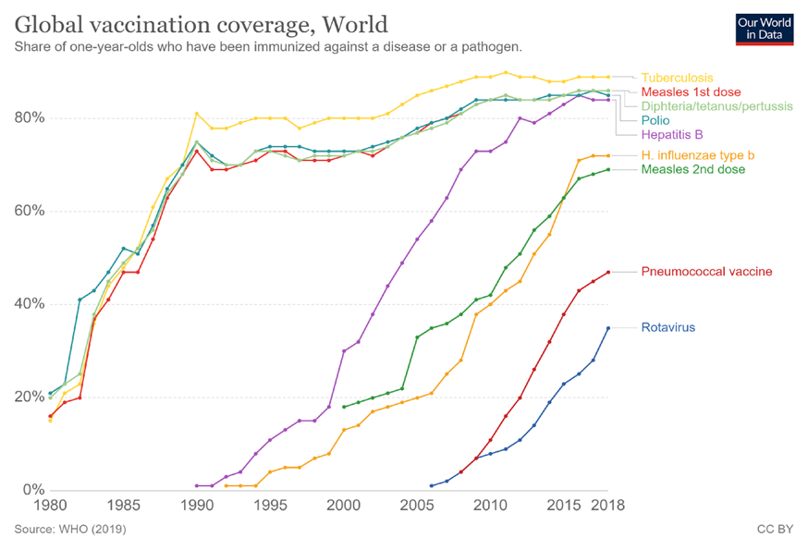
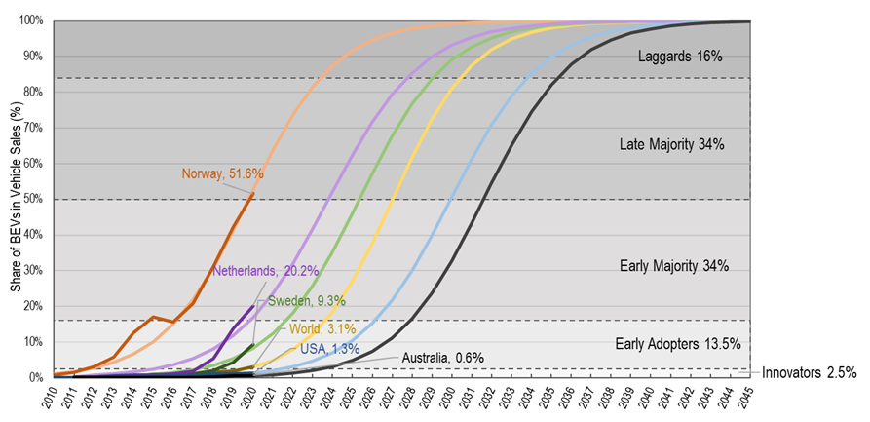
Examples of s-curves - Technological, social and policy innovations
Vaccine coverage
Share of electric vehicles

Slide 17
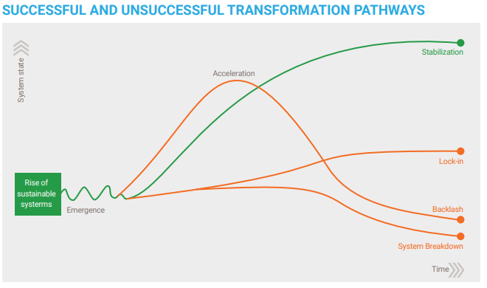
Capacities for dynamic transformations
Nurture innovation
Give strategic direction
Manage impediments

Slide 18
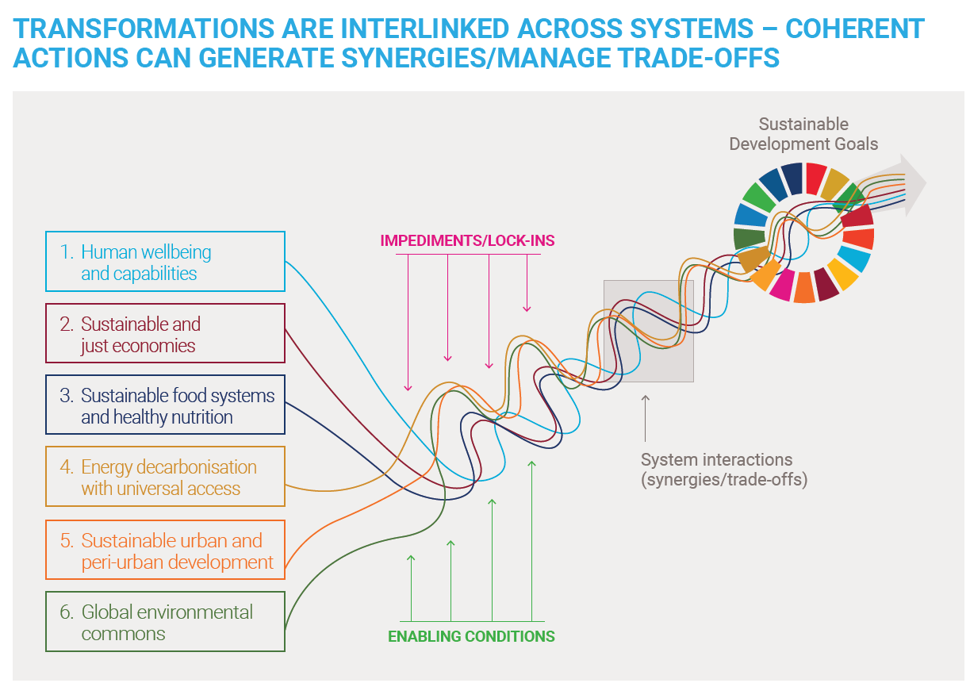
Capacities for integrated transformations
From a single
“s-curve”
–
to integrated
“SDG-curves”

Slide 19
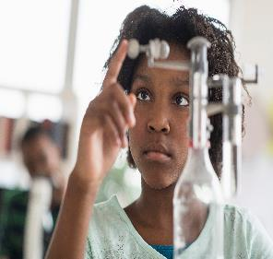
4: Transformations Through Science
“Science lies at the heart of sustainable development” -> GSDR 2019
BUT we know a lot already, how can society – including scientists –speak more convincingly to government– to inspire bold decisions - to use the power of science and technology as an effective lever for starting, accelerating and stabilizing transformation.
Notes:
Chapter explores and explores new relationships and equilibriums – based on science that is multidisciplinary, equitably and inclusively produced, openly shared, widely trusted and embraced, and “socially robust”—relevant to society.

Slide 20
Goal: “Science-Policy-Society” Interface…and it’s happening…
Notes:
AN INCLUSIVE model of Science-Policy-Society Interface
A few decades ago, the “science-policy interface,” or points of interaction between scientific knowledge and the policy-making process, primarily involved experts in individual scientific disciplines – usually in the Global North, predominantly male and in mid- to late-career. These individuals spoke to career policymakers, demographically similar people working in government, economics, and law. This interface fed into a four-stage policy formulation cycle: agenda-setting, policy formulation, implementation, and review. Within this largely linear sequence, policy makers expressed their priorities to the science community who responded with factual information and advice.
For achieving sustainable development in the 21st Century, however, the interactions will need to be far more multi-directional and multi-disciplinary, expanded to address complex and interlinked challenges and goals. This requires an inclusive model of ‘science-policy- society interface’ (Figure 4-1). Recognizing this, the international community has created platforms through which scientists, policymakers, and knowledge brokers can interact and capitalize on the latest information. These include the Montreal Protocol for the ozone layer (1987), the Intergovernmental Panel on Climate Change (IPCC) (1988), and the Intergovernmental Science-Policy Platform for Biodiversity and Ecosystem Services (IPBES) (2012).584 2523

Slide 21

Transformations can be rooted in “socially robust” science.
Socially-robust=
Production of scientific knowledge rooted in real-world application
Many Sources of Expertise
Extended peer communities to frame, exchange, and review knowledge to ensure quality ( also a good offset fake news…)
Indigenous
Civil Society Org
University

Slide 22
Addressing….Global imbalance in research and development
GERD ~4X> in high income countries (most $ from private industry)
The inequality=> impt questions not asked, important results not always equitably distributed.
Inequality Excerbated by COVID19 Vaccine Production and COVID19 Vaccine Distribution
Notes:
Between 2013 and 2018, the per capita gross domestic expenditure on research and development (GERD) was four times higher in high-income countries than the average for other countries, and as a proportion of GDP was more than twice as high (Figure 4-5). Ten countries account for 80 per cent of spending. In addition, over this period, in low and lower-middle income countries GERD as a percentage of GDP decreased. As a result, more than 70 per cent of the world’s population are served by relatively small research and development (R&D) system, with clear implications for developing solutions that can advance context-specific SDG implementation in the Global South. This also means that countries in the Global South may often lack the capacity to absorb or adapt technological advances developed elsewhere.
There have been severe inequalities around vaccine production and distribution, such that high-income countries had the first access to vaccines and were administering boosters before residents of other countries had received first or second doses. In addition, COVID- 19 has exacerbated inequities in R&D funding. Donors have used some overseas development assistance R&D funds for work on COVID-19 while other research activities have slipped. In a global pandemic, the large public research funders of the world would be expected to direct resources towards strengthening R&D capacities in low-income countries, too, and not leave this to development cooperation whose resources are already stretched.

Slide 23


Outputs of research, metadata, should be freely accessible with no borders – geographical, temporal, social or cultural, ➔ expands use of science towards the attainment of the SDGs
OPEN SCIENCE
…we see an emerging SCIENCE-POLICY-SOCIETY INTERFACE that leads to enhanced global cooperation and multilateralism
BUT progress depends on sharing knowledge openly and equitably
OPEN SCIENCE:
A shift to open science can change how research is done, who is involved, and how it is valued.
Mobilizing knowledge to influence public policy, the education system and public understanding.
Public interest groups, policymakers, industry and teachers should have access to all underlying scientific research including publications, data and software

Slide 24
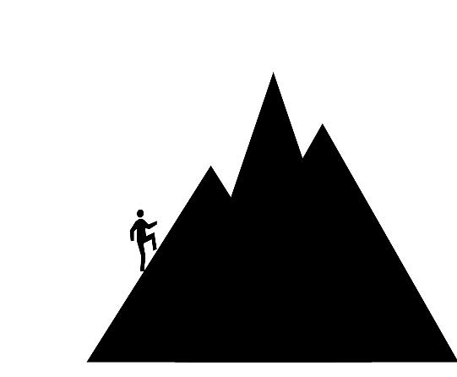

Trust and Integrity
States, media outlets and regulatory bodies should explore a GLOBAL CODE OF CONDUCT that promotes integrity in public information, facilitated by the United Nations
Time to better manage and regulate the digital commons as a global public good
UN Secretary General, in Our Common Agenda
Agenda 2030
Fake News
Science-Society

Slide 25

Socially robust science may bridge the gap between policy commitment and policy implementation
IPCC is a well-developed global scientific process yet…we are not on track to stay “Below 1.5C”
Broadening towards a Science-Policy-Society Interface can only help…..
Target -Below 1.5C
Notes:
Government pronouncements on the SDGs are generally sincere, but progress is limited by a lack of capacity, data limitations, existing trade-offs between goals and policies, incomplete understanding of economic or ecological processes, or by worry that a given action may be unsuccessful. And in some cases, the problems are so complex that even the formal scientific method based on testing hypotheses does not always capture the reality of ‘wicked’ problems; increments in knowledge do not necessarily reduce uncertainty.
For many countries, action for the SDGs can be impossible because of political unrest and conflict. The scientific evidence may be clear, but the way that it informs policy is often influenced by political and economic interests, public Bs, and even stages in the election cycles. Even when the weight of scientific evidence may be overwhelming, the necessary actions are fraught with political and technical complexities—as is the case when a well- developed global process such as IPCC has not resulted in full-scale transformation. Despite all of the available scientific evidence that characterizes the risk of drastically endangering the current status quo, we have not fully addressed the global carbon footprint. We are not on track to stay “Below 1.5 C”.

Slide 26

Chapter 5: Call to Actions in 5 Themes
Establish an SDG Transformation Framework for Accelerated Action by 2024
How to Build Capacity of State and Non-state-holders
How to use Levers in an integrated way to overcome impediments along the S-curve
Identifying interventions (for each Entrypoint) that will capitalize on SDG synergies and minimize trade-offs and spillovers
Identify measures to accelerate implementation.
… For today, we will focus on the First Call to Action theme.
Notes:
For today, we will focus on the First Call to Action theme.

Slide 27
Establish an SDG Transformation Framework for Accelerated Action by 2024… to include components such as…
Set global priorities that guide national prioritisation of SDG action
Analysis of SDG interlinkages
ID Synergies, Bottlenecks and Multilateral commitments:
Minimize Environmental tradeoffs, transboundary spillovers
Identification of key interventions to achieve Multiple Goals

Slide 28
In Closing……
Against the backdrop of the changes and shocks of the last few years, the 2030 Agenda for Sustainable Development remains a strong and valid agenda for a desirable future – for people, planet, and prosperity in peace.
Making progress on the SDGs is an insurance/building resilient systems against new crises and shocks

Slide 29
Thank you
Notes:
Thank hosts

Slide 30
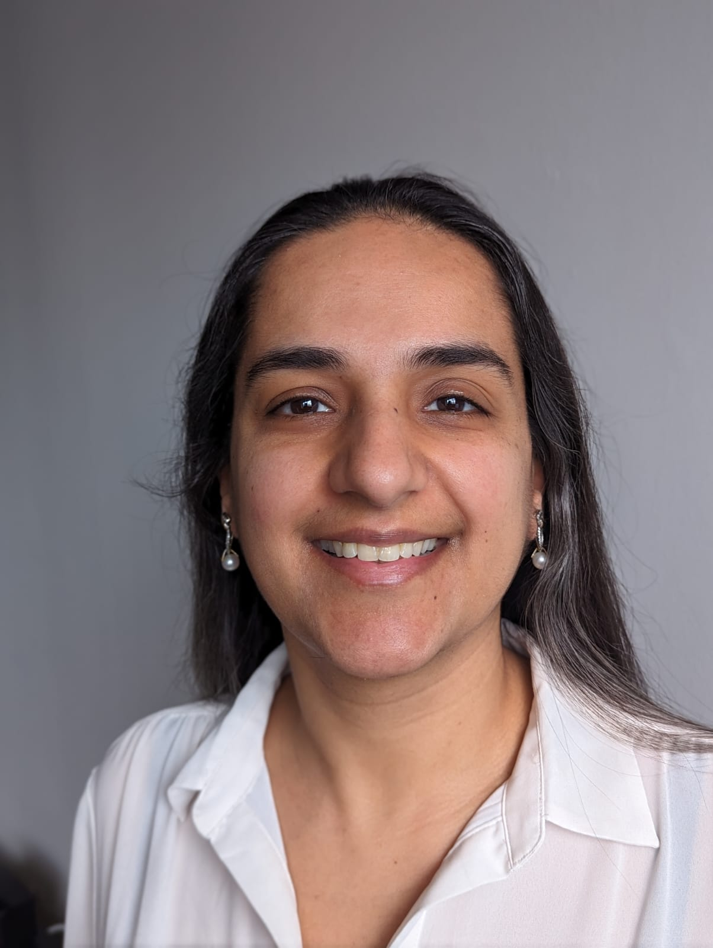
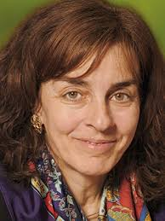




Moderated discussion with private sector representatives
Cristina Moral
Senior Advisor Climate Policies and International Alliances, Iberdrola
Kathleen Ebersohn-Khuvutlu
Senior Sustainability Manager, Old Mutual Limited
Mardi McBrien
Director of Strategic Affairs, IFRS Foundation
MODERATOR
Shivani Nayyar
United Nations Department of Economic and Social Affairs (UNDESA)
Norine Kennedy
Senior Vice President, United States Council for International Business (USCIB)
Silvano De Marte
External Advisor
International Organisation of Employers (IOE)
Questions/Comments? Please use the Q&A box and clarify which speaker it is addressed to. Thank you!

Slide 31
Q&A
You can either raise hand in Zoom to ask for the floor or share comments/questions in the Q&A box.
Please identify yourself (name and organization) at the beginning.

Slide 32
Thank you!
For more information about the 2023 GSDR, please visit https://sdgs.un.org/gsdr/gsdr2023
Follow us on Facebook/Twitter @SustDev for latest intergovernmental updates related to the SDGs.

